Slide 1
ITCS253 Discrete Mathematics II
Recurrence Relations
Dr. Ali Alsaffar Department of Computer Science

Slide 2
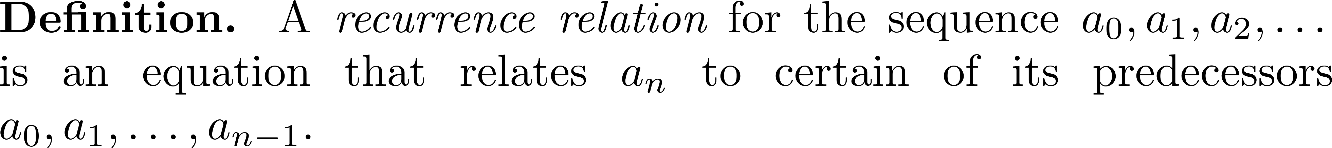
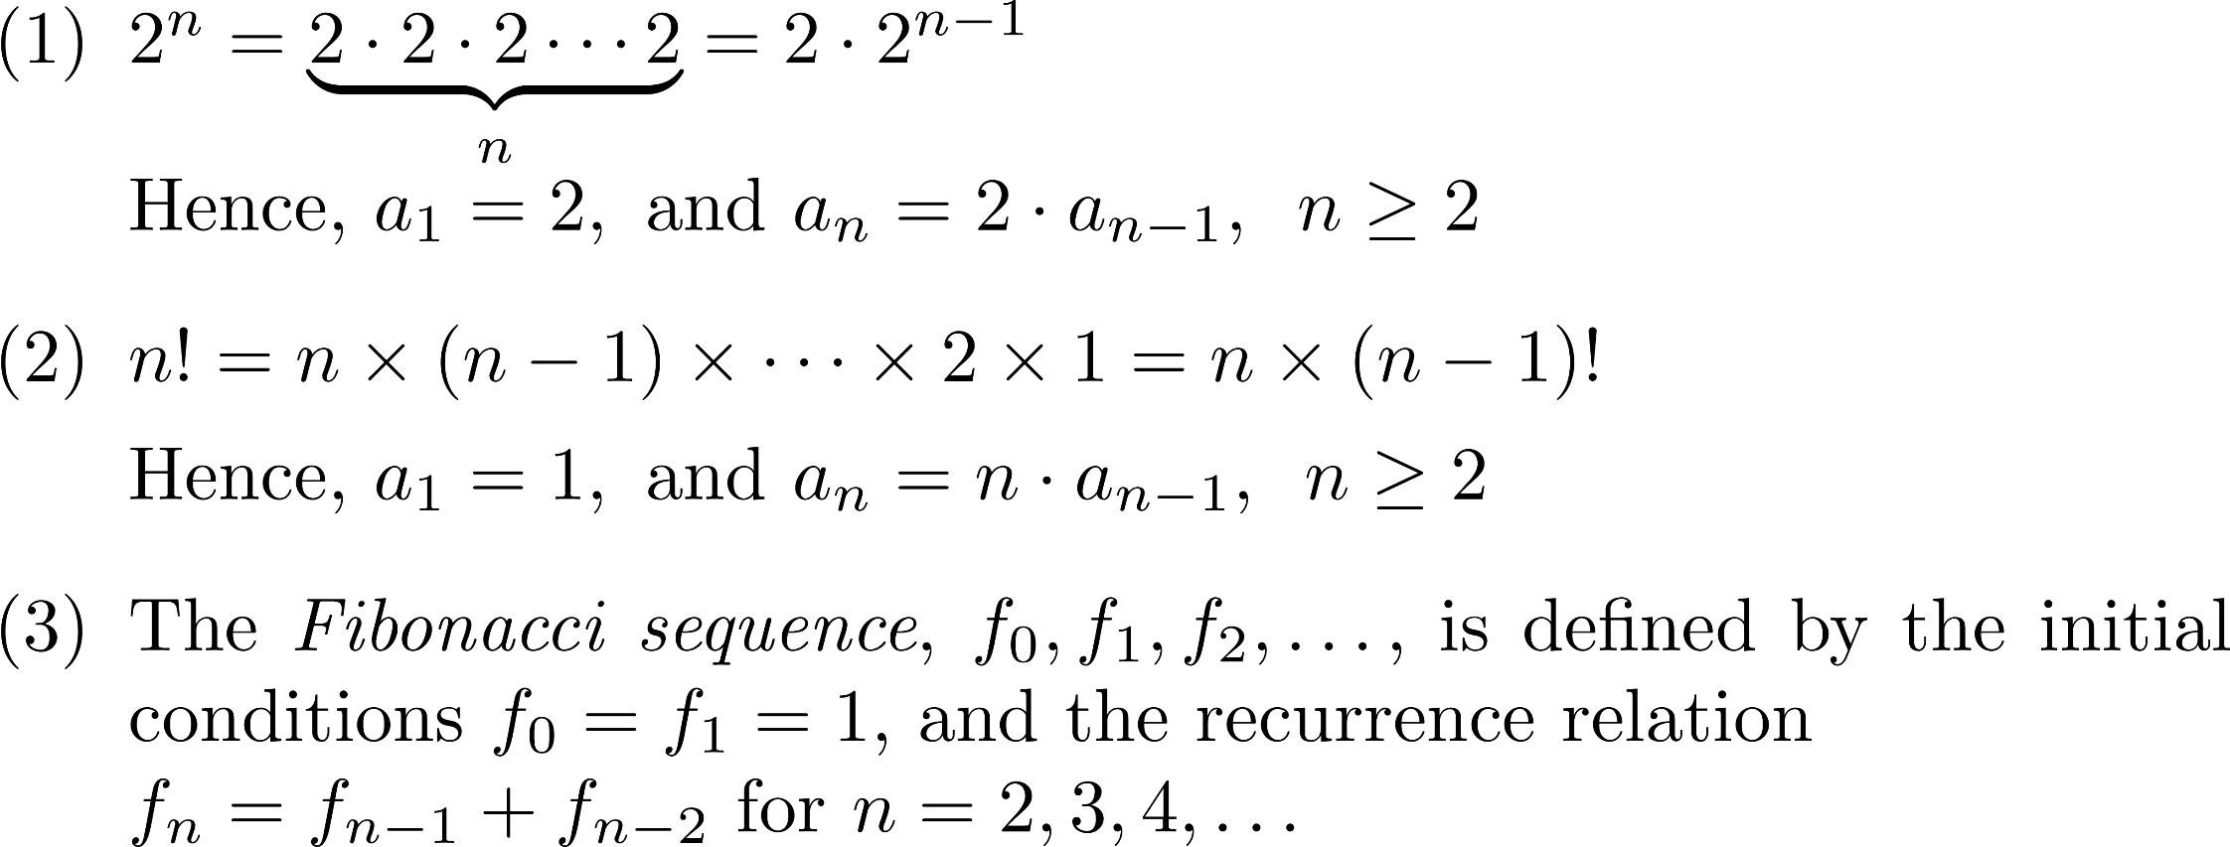
Recurrence Relations

Slide 3
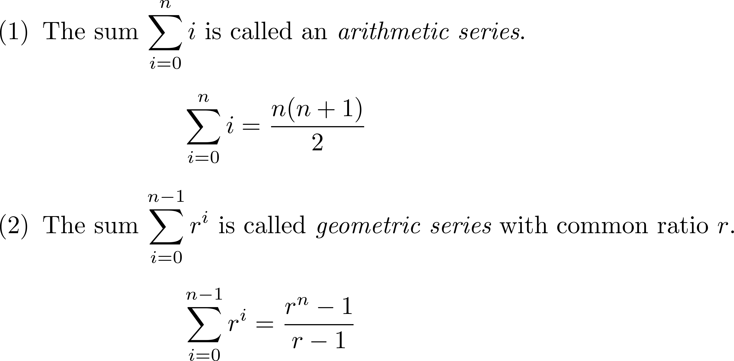
Mathematical Review

Slide 4
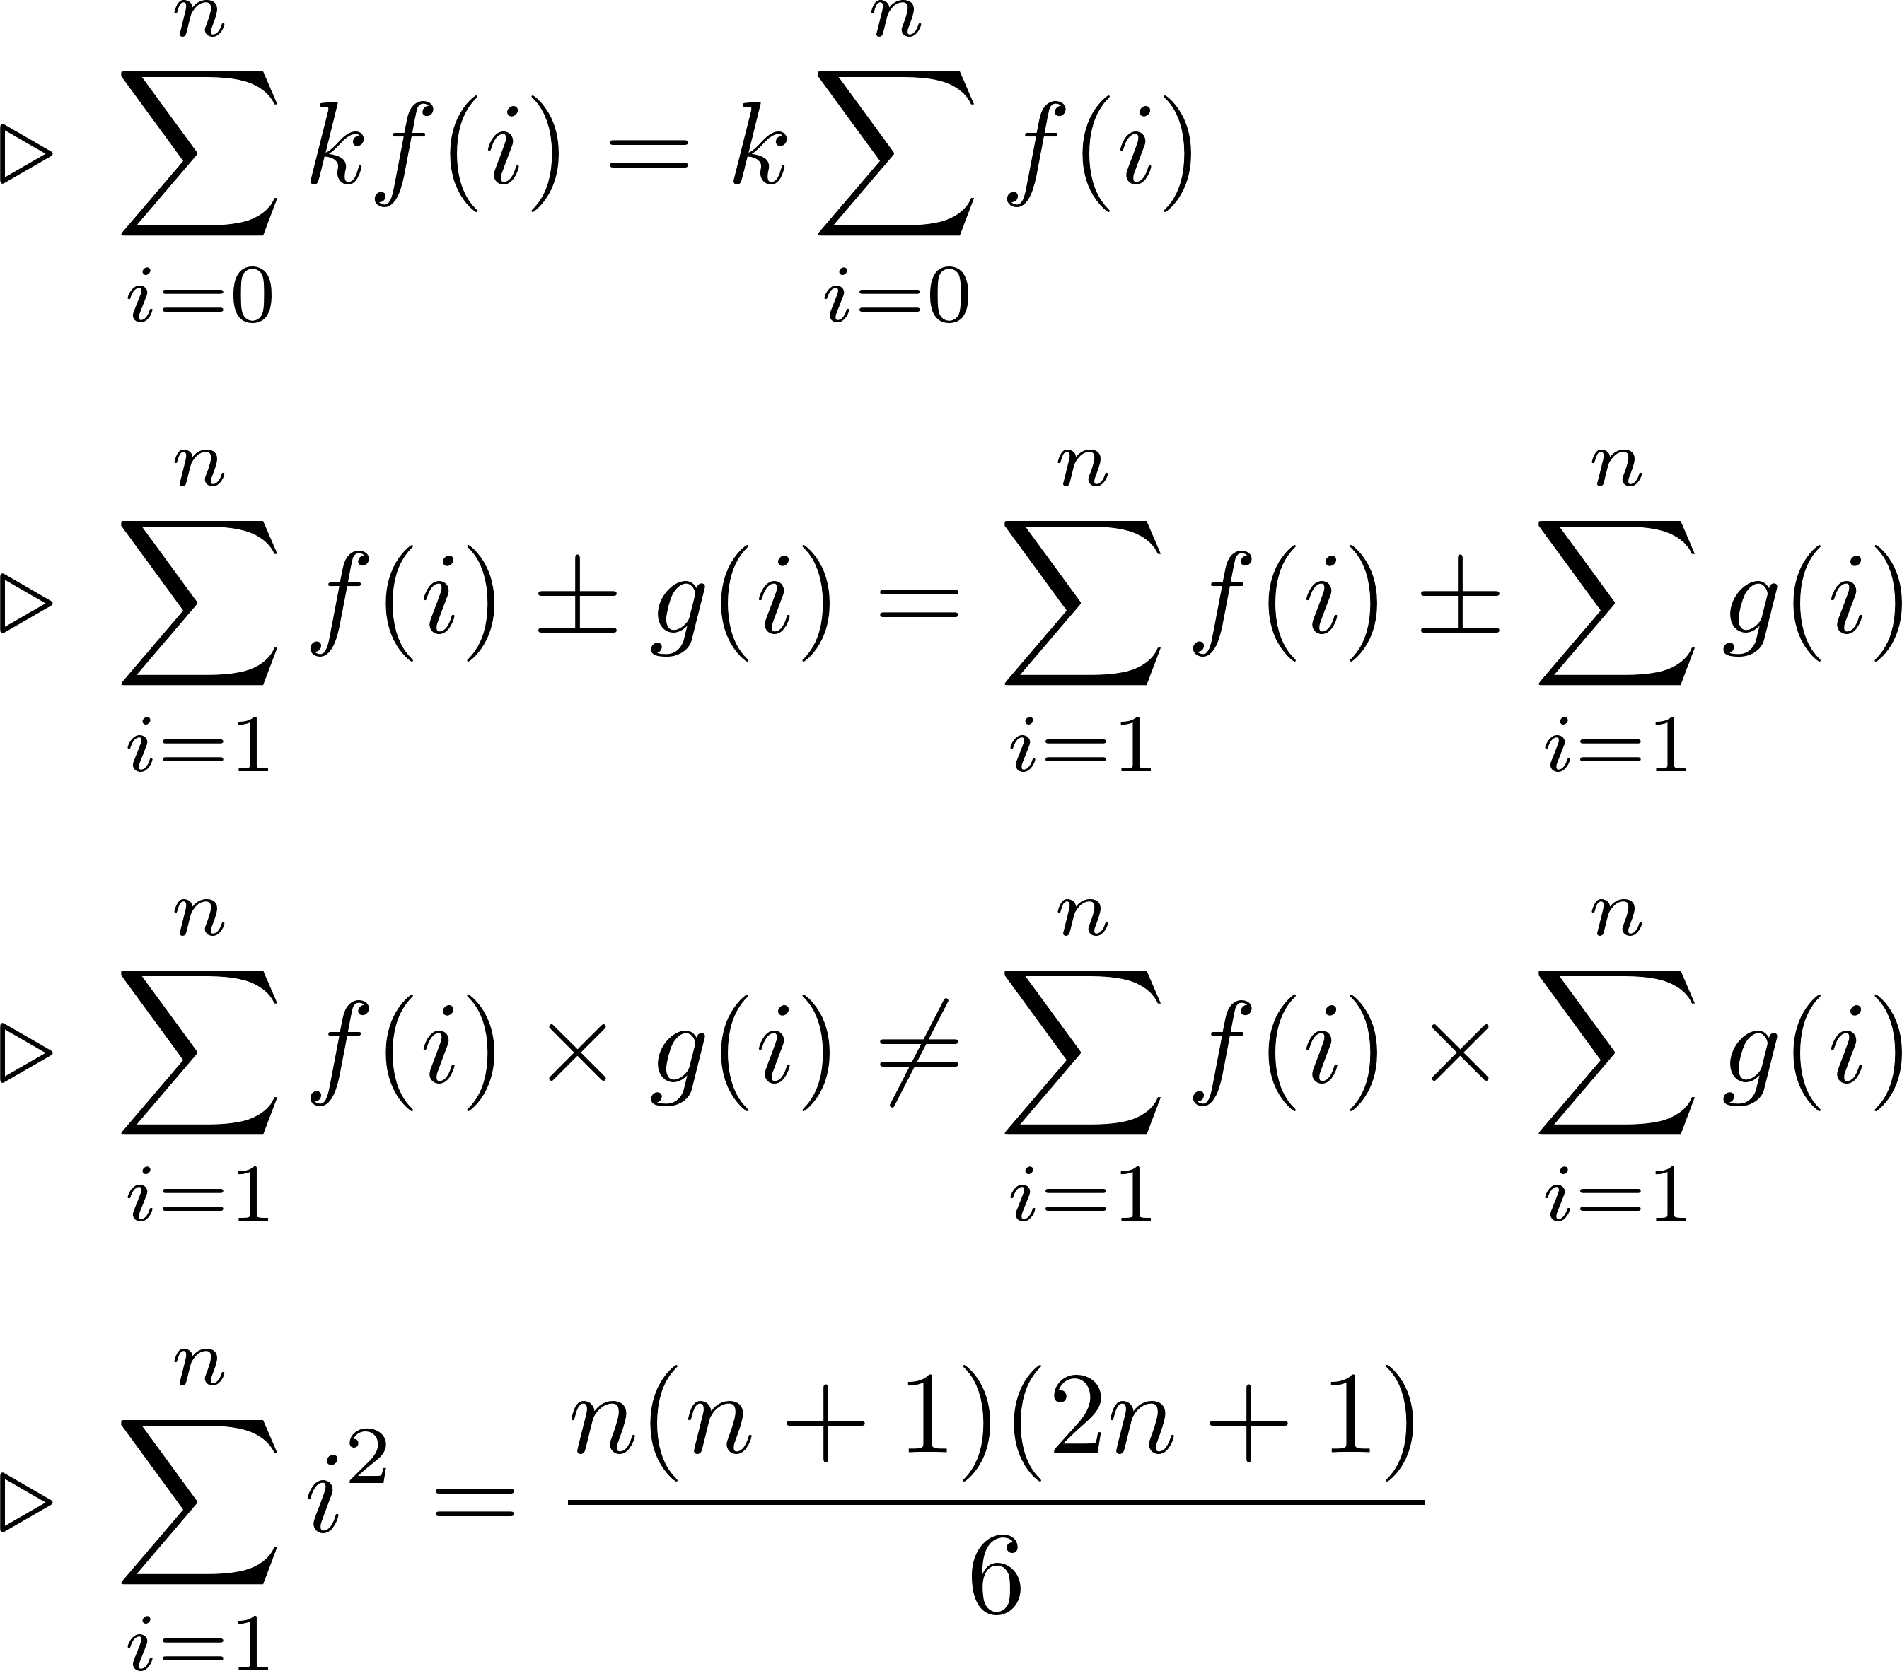
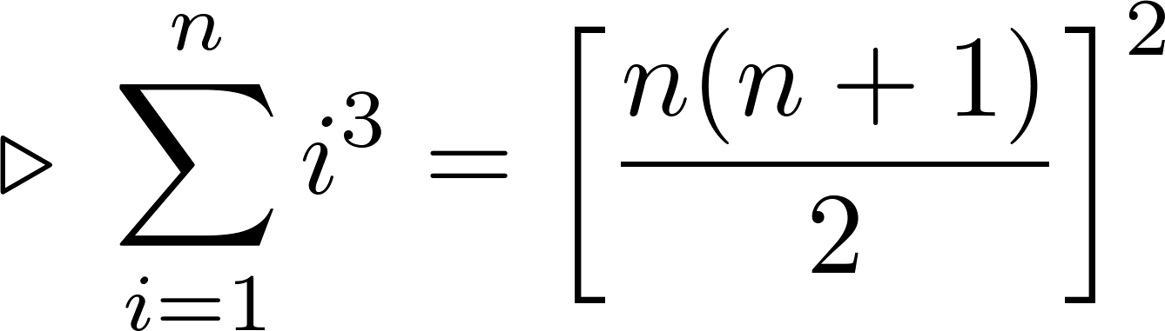
Properties of Summations

Slide 5
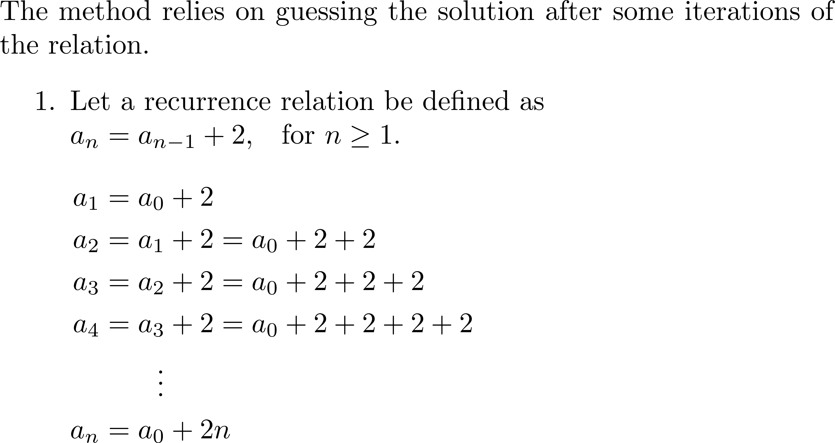
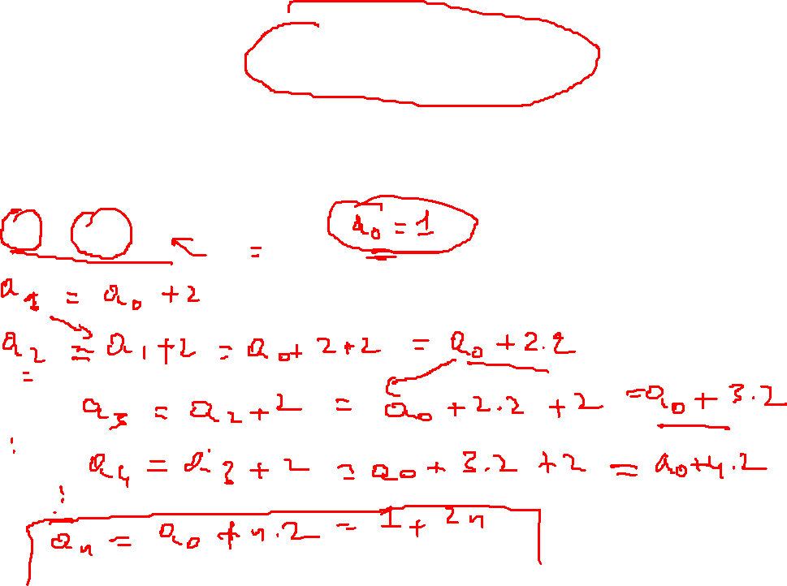
Iteration Method (Forward Chaining)

Slide 6
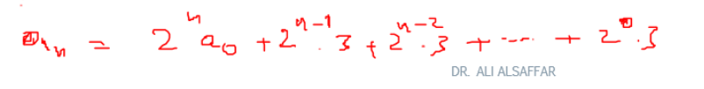
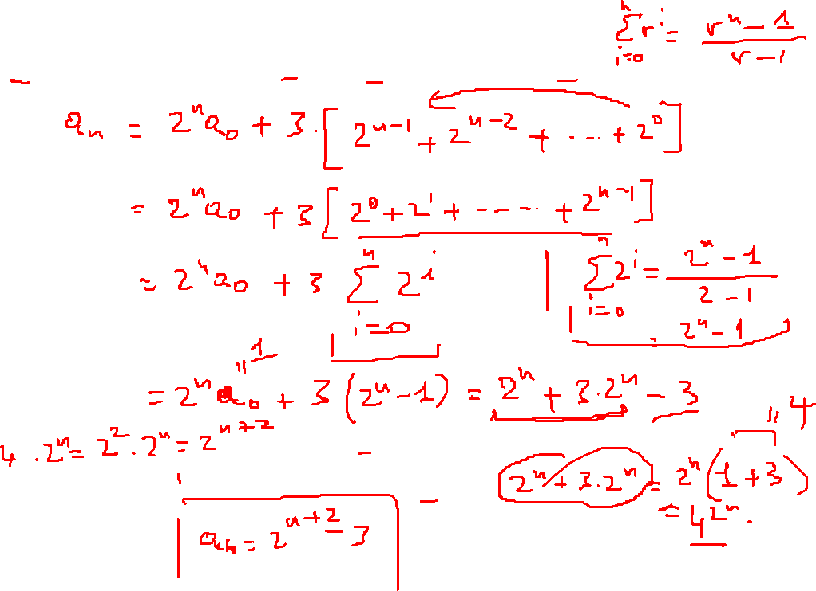

Slide 7
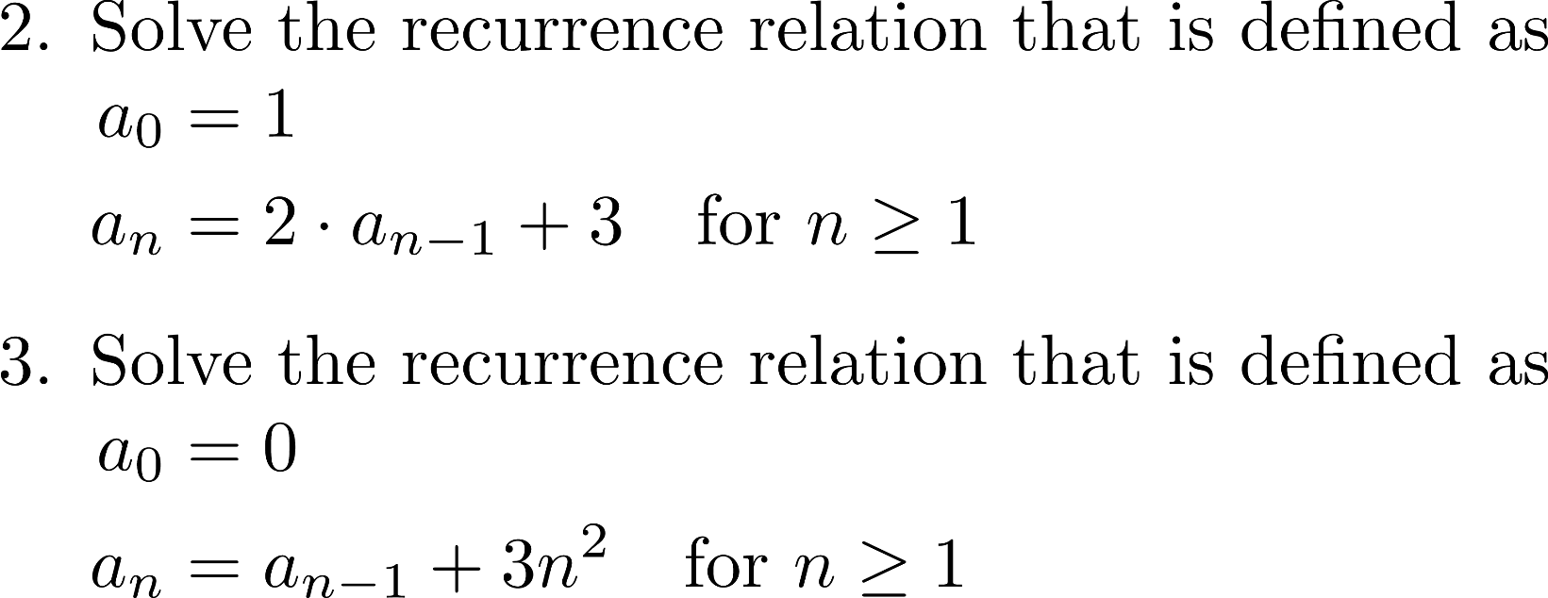
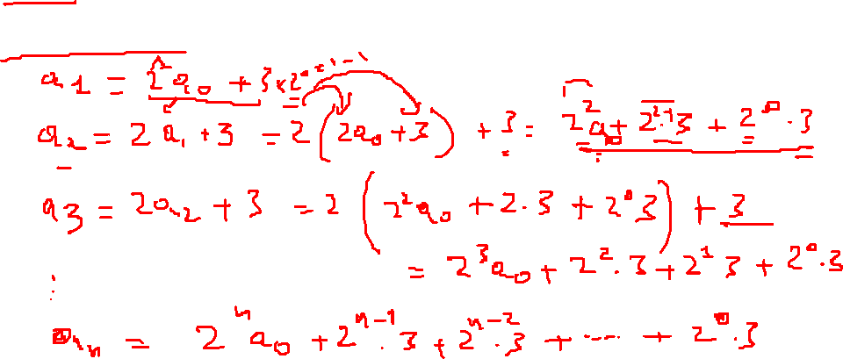
Forward Chaining (Cont.)

Slide 8
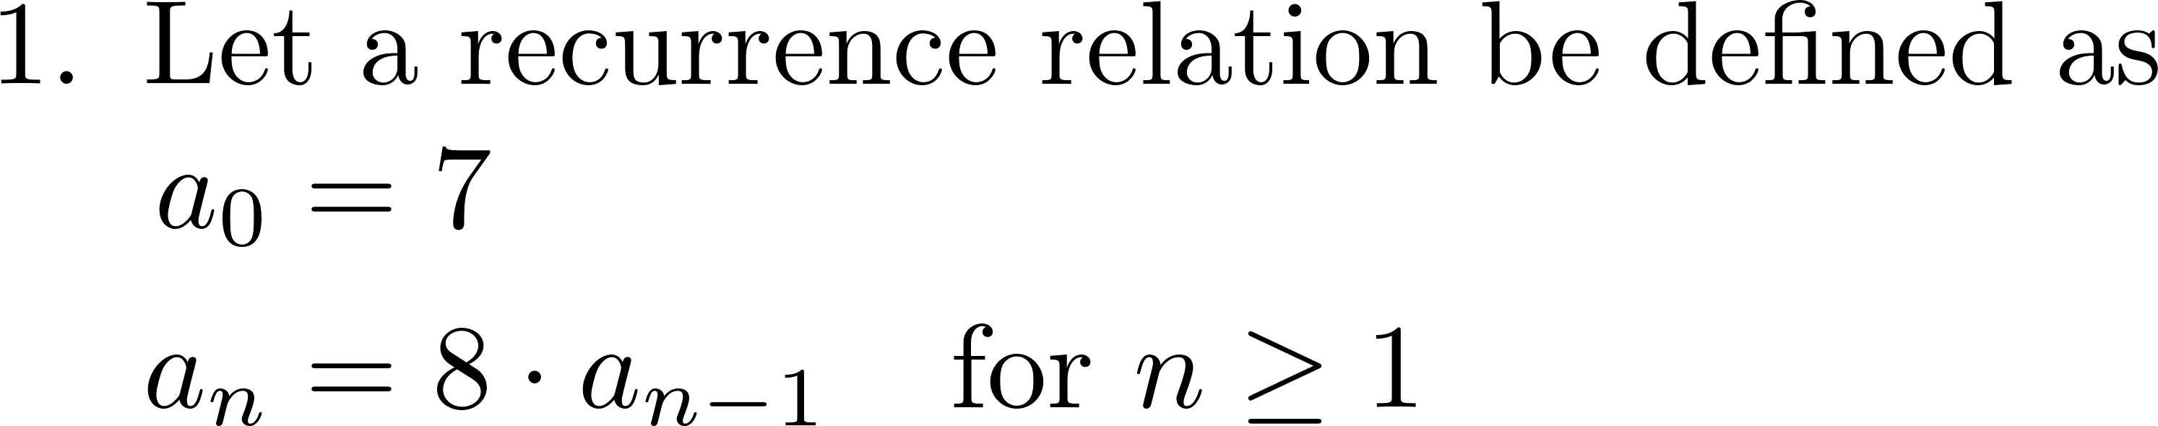
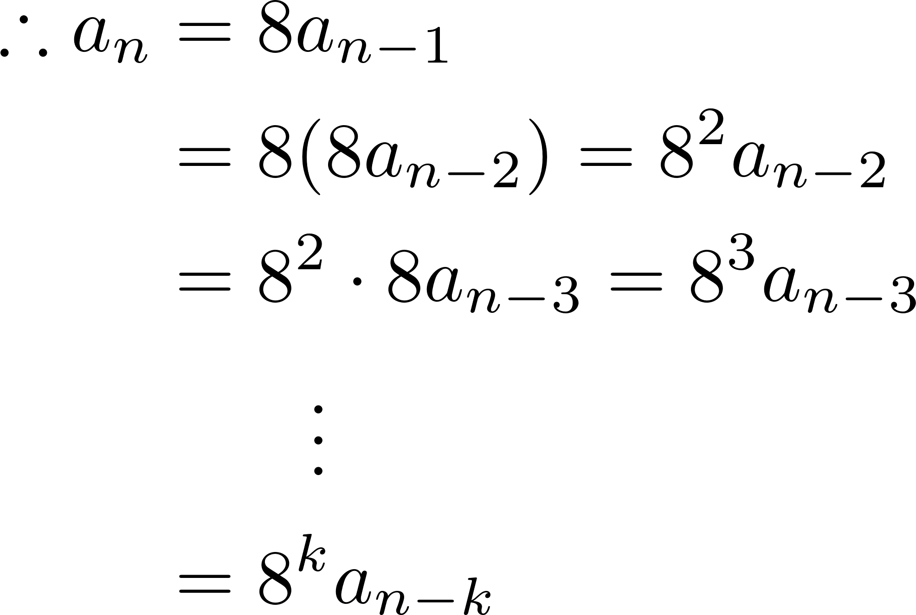
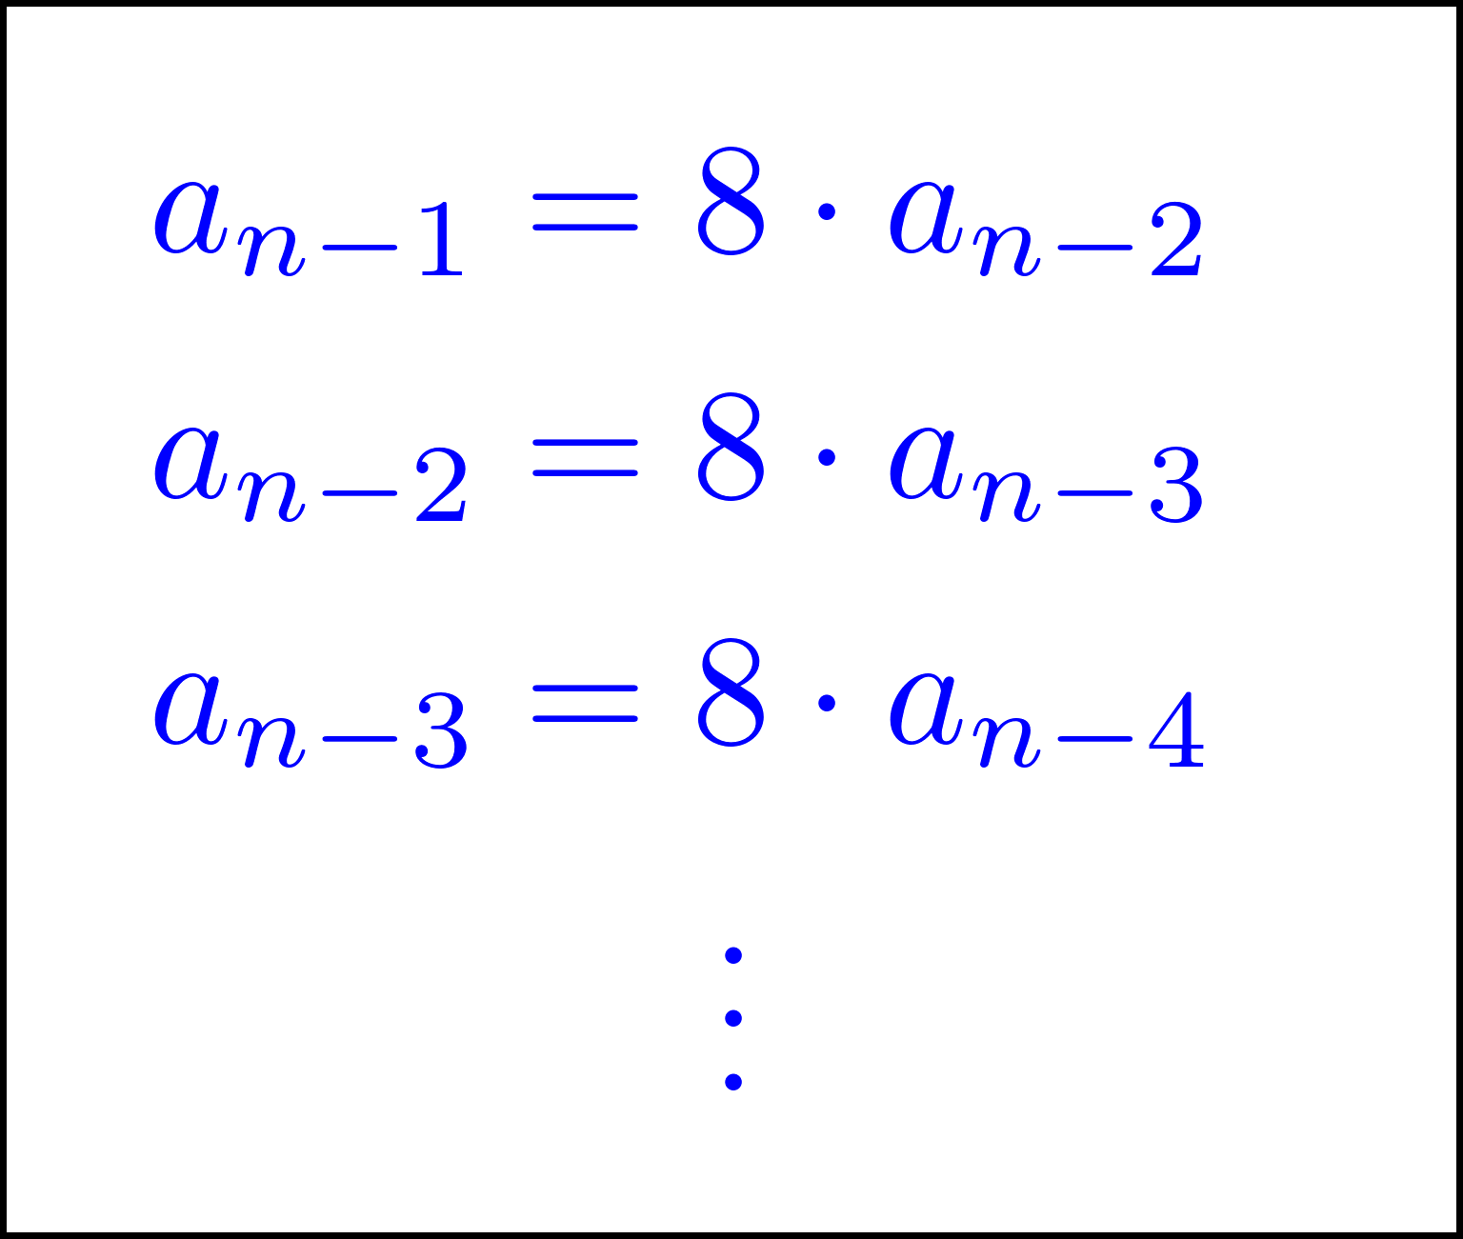
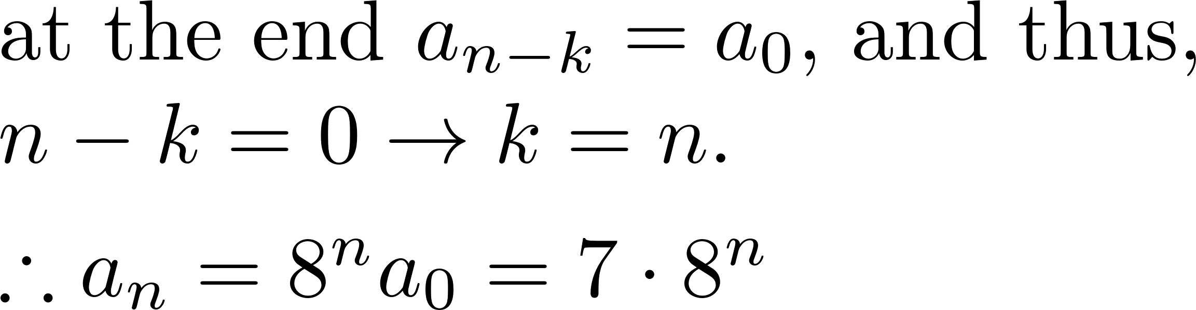
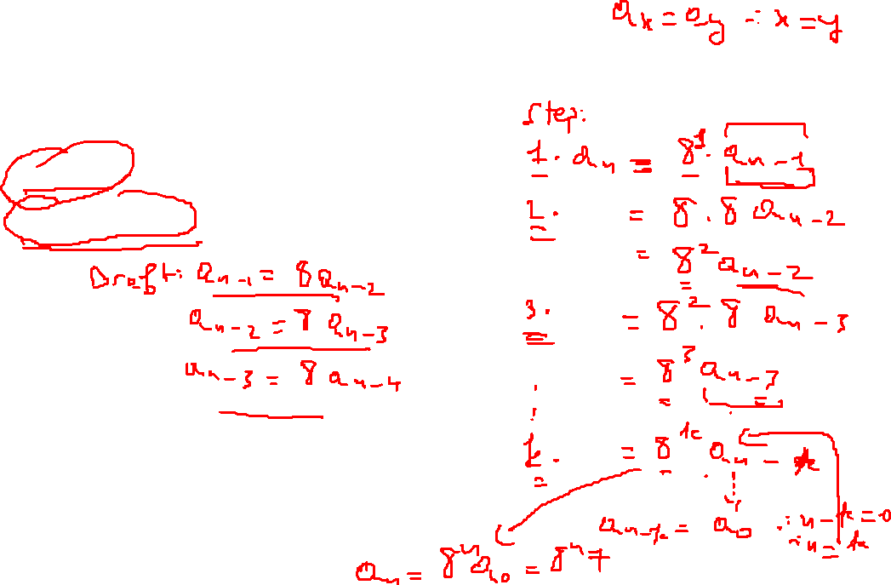
Iteration Method (Back Substitution)
Substitute

Slide 9
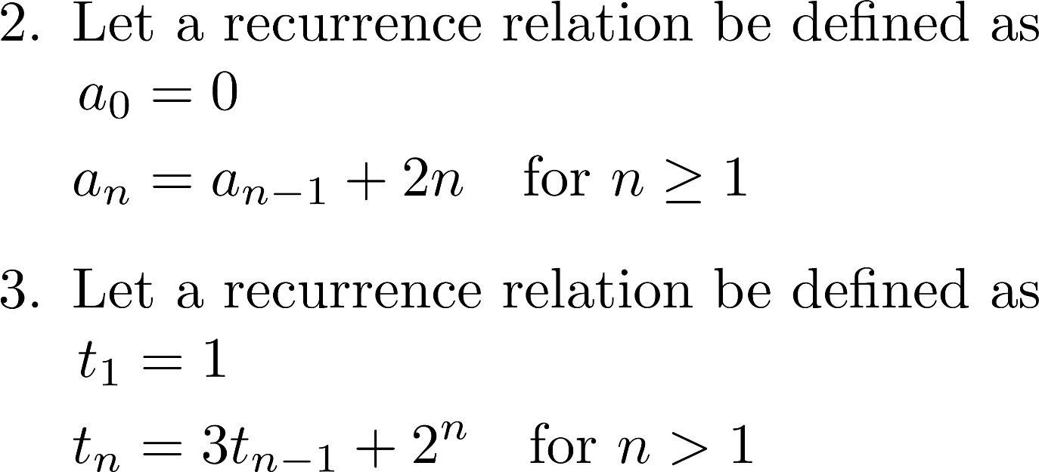

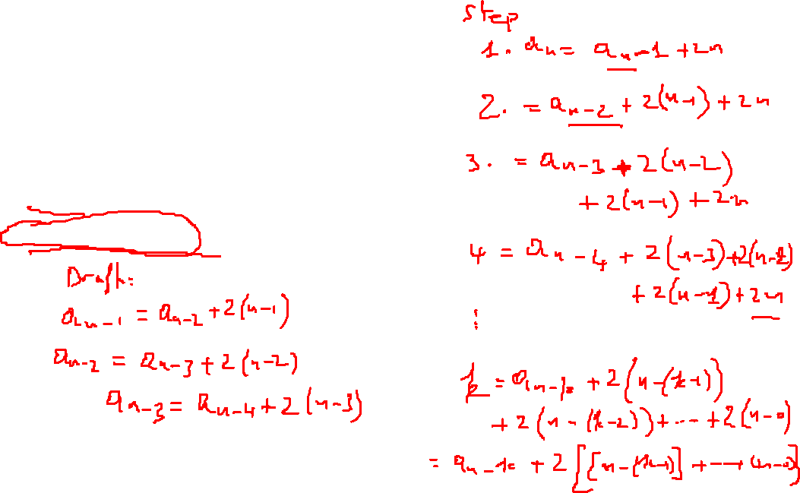
Back Substitution (Cont.)

Slide 10

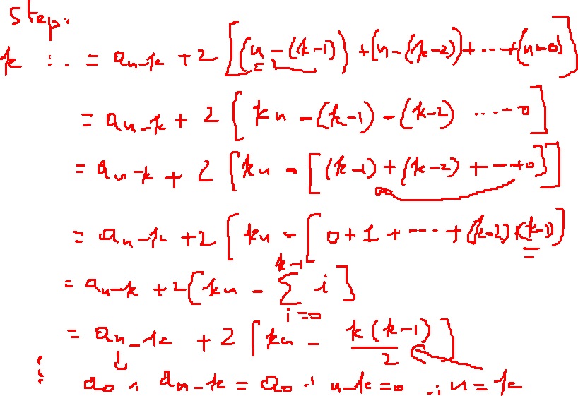

Slide 11
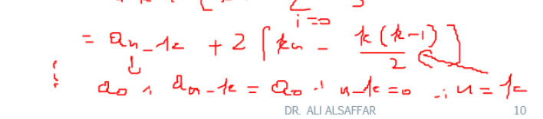
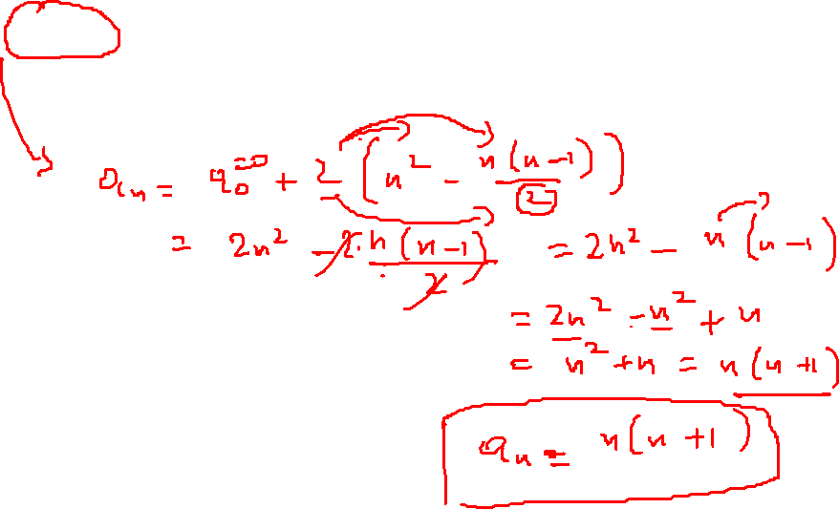

Slide 12


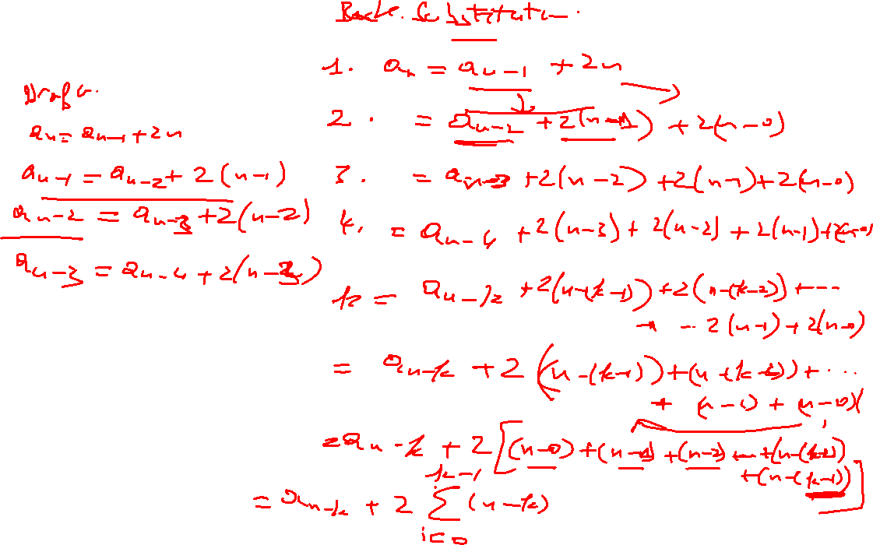

Slide 13
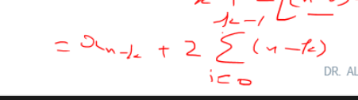
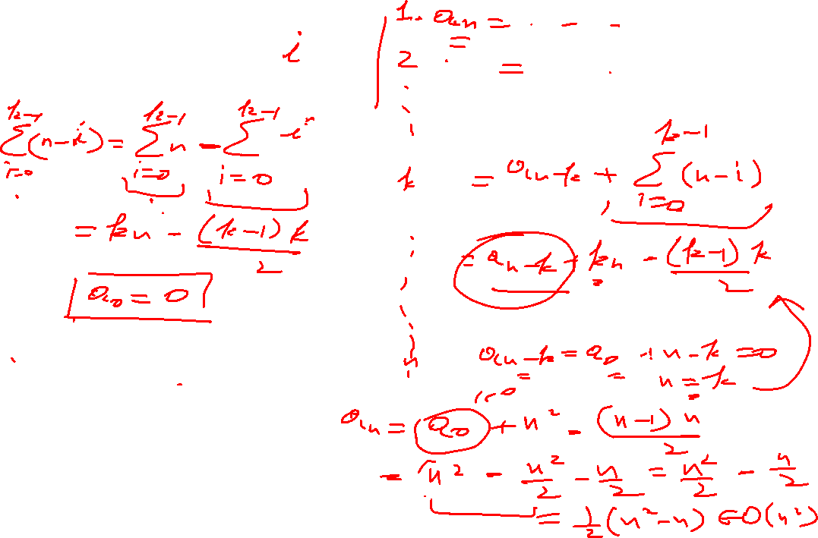

Slide 14
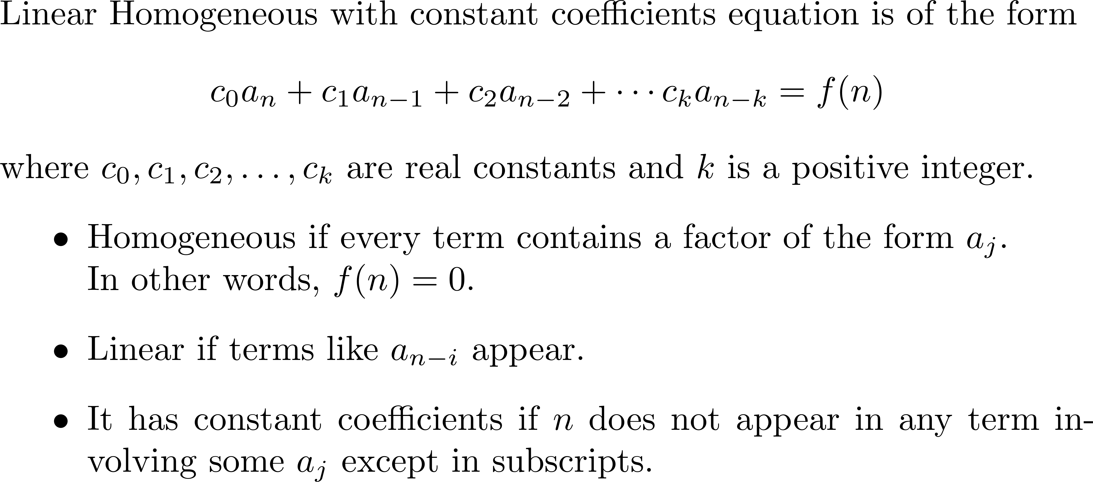
Linear Homogeneous with Constant Coefficients

Slide 15
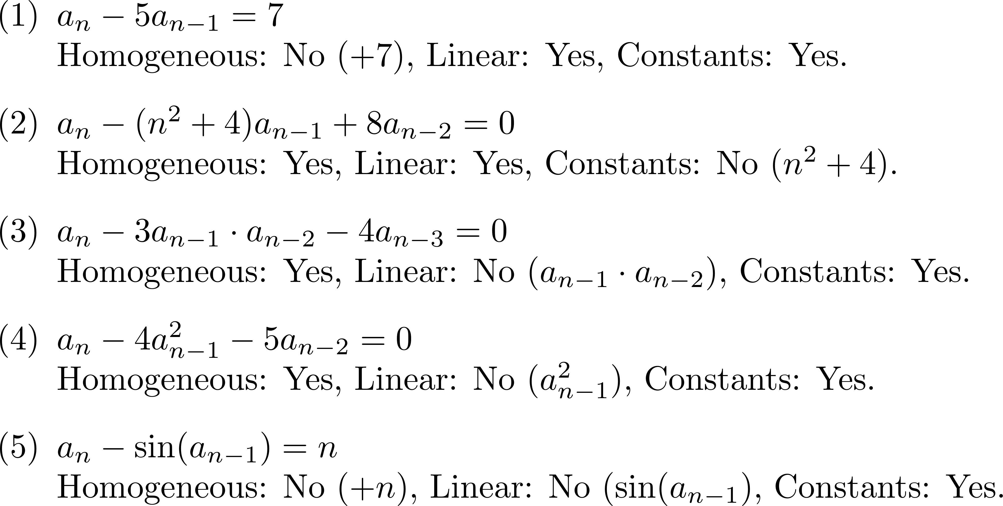
Examples

Slide 16
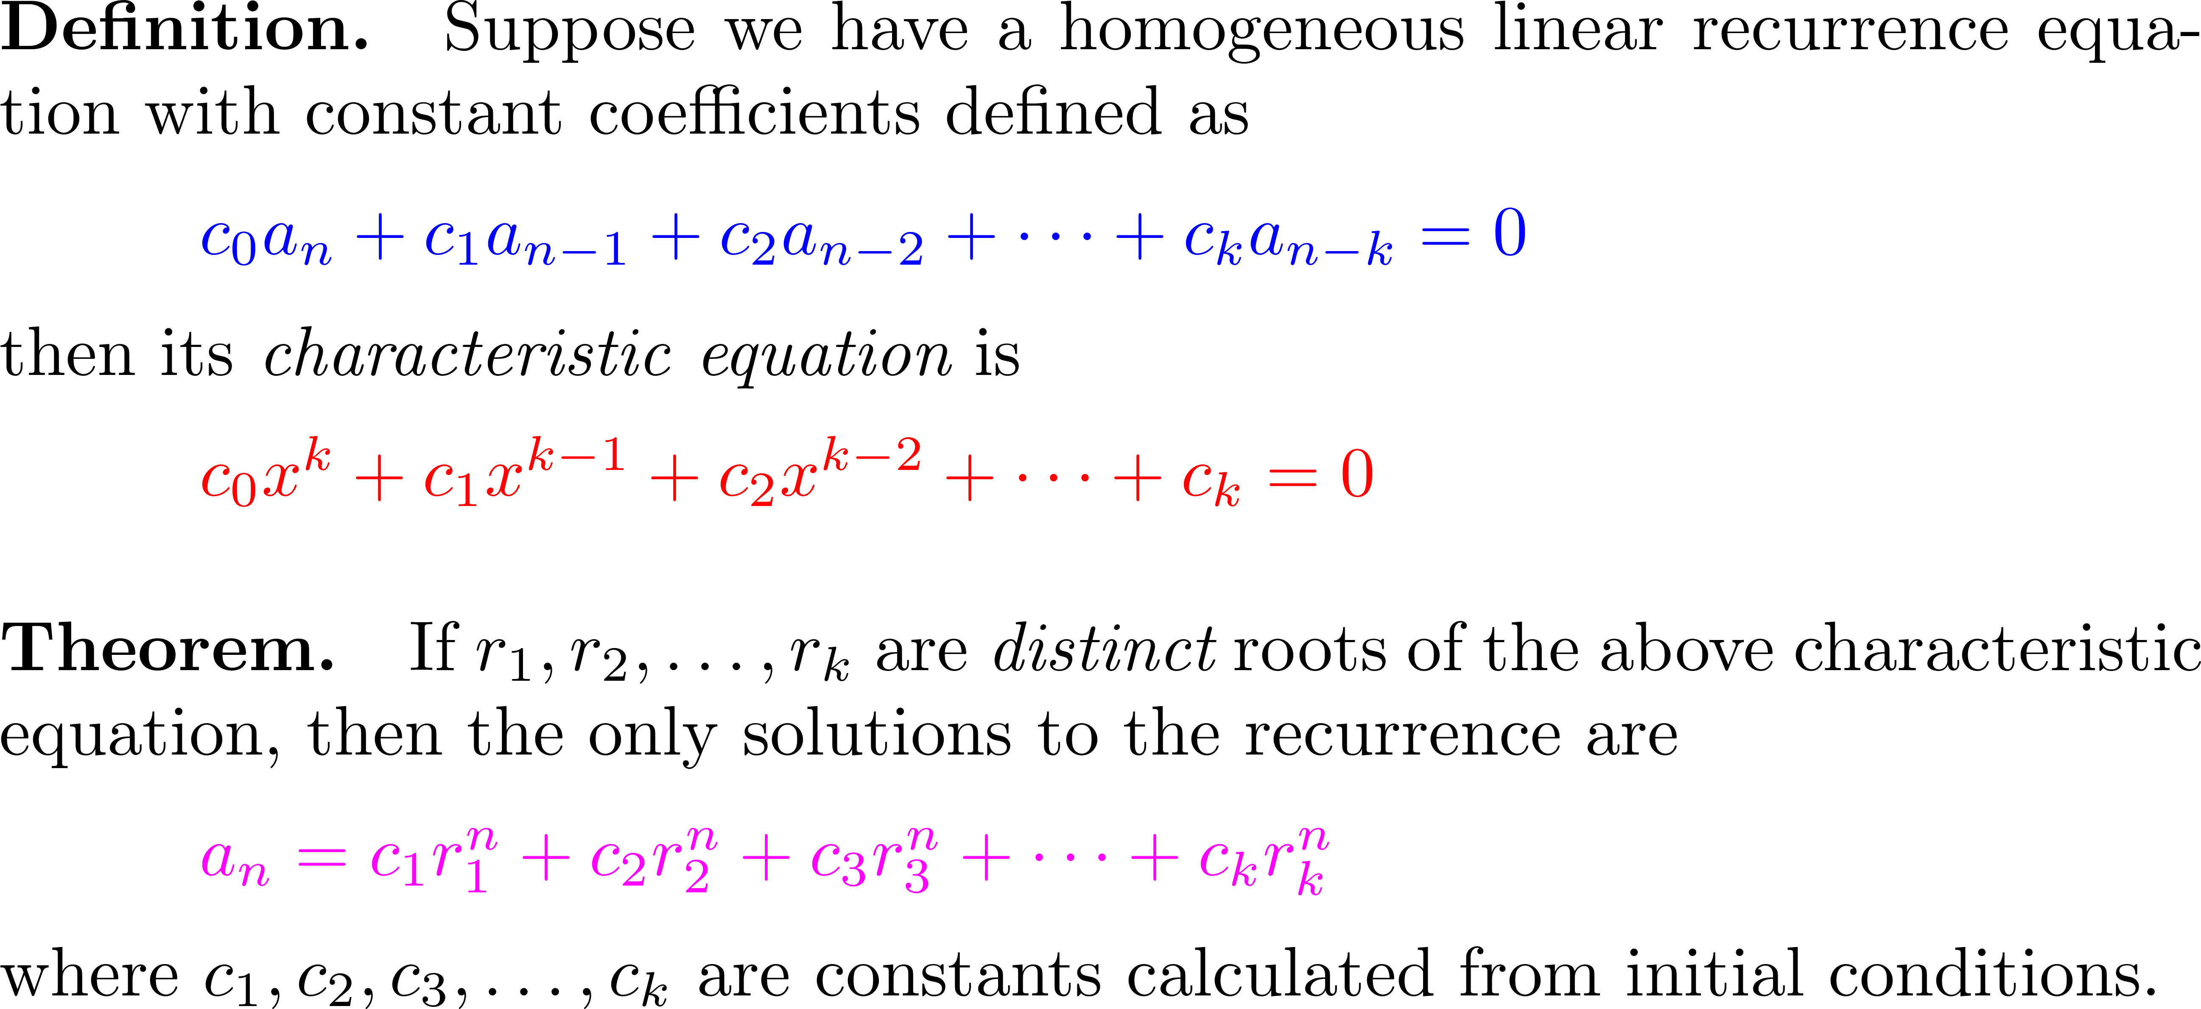
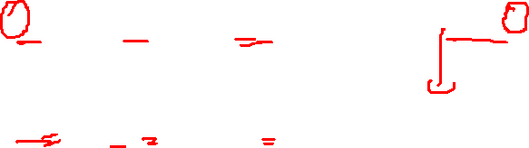
Linear Homogeneous with Constant Coefficients having Distinct Roots

Slide 17
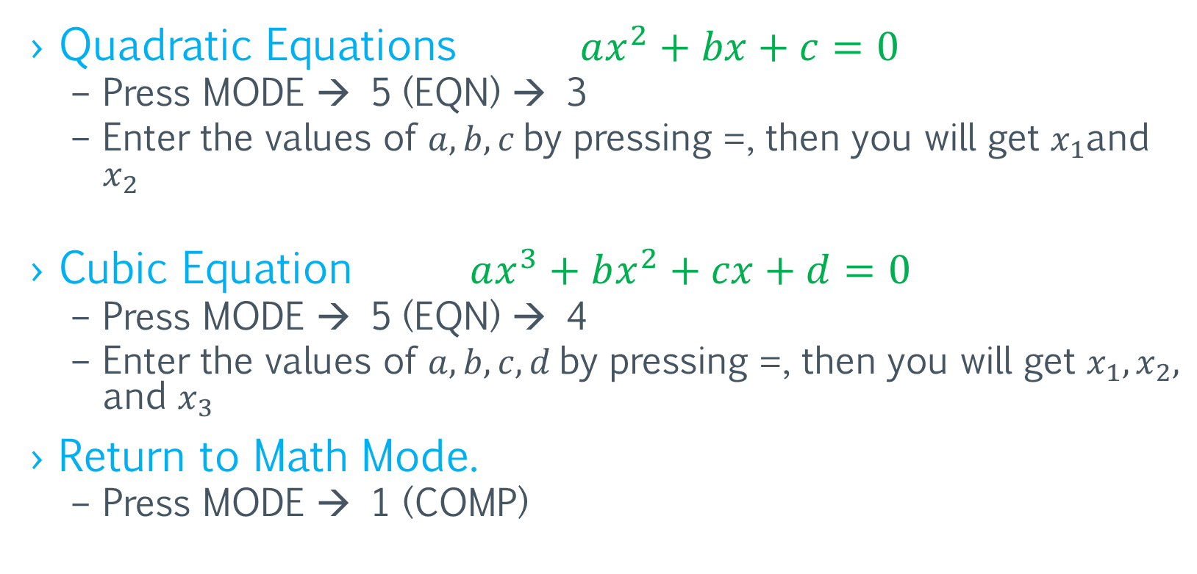
Using CASIO fx-991ES PLUS calculator to find the roots
Quadratic Equations $ax^{2}+bx+c=0$
Press MODE → 5 (EQN) → 3
Enter the values of $a,b,c$by pressing =, then you will get $x_{1}$and $x_{2}$
Cubic Equation $ax^{3}+bx^{2}+cx+d=0$
Press MODE → 5 (EQN) → 4
Enter the values of $a,b,c,d$by pressing =, then you will get $x_{1},x_{2},$ and $x_{3}$
Return to Math Mode.
Press MODE → 1 (COMP)

Slide 18
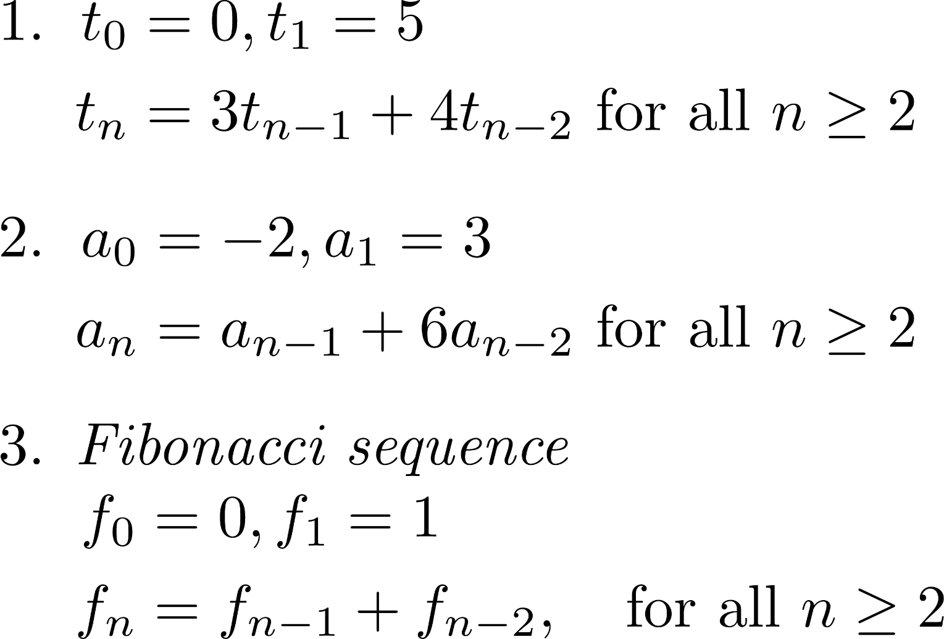
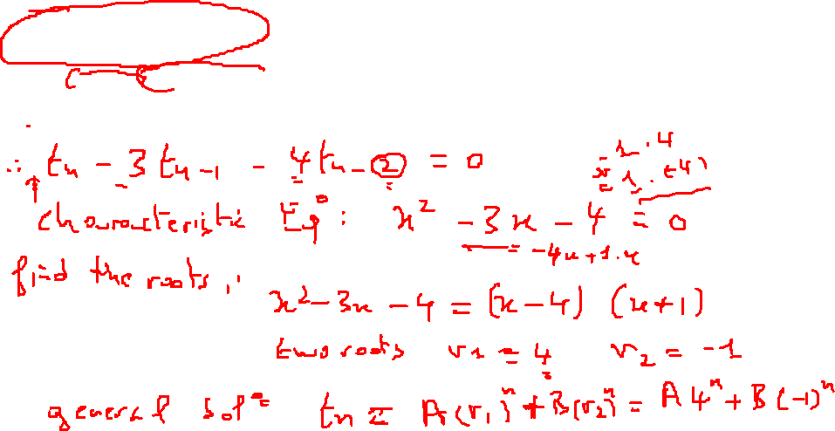
Examples

Slide 19
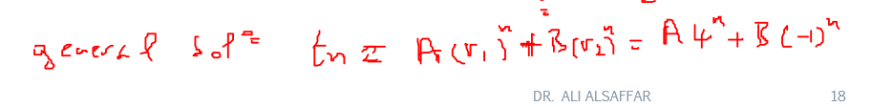
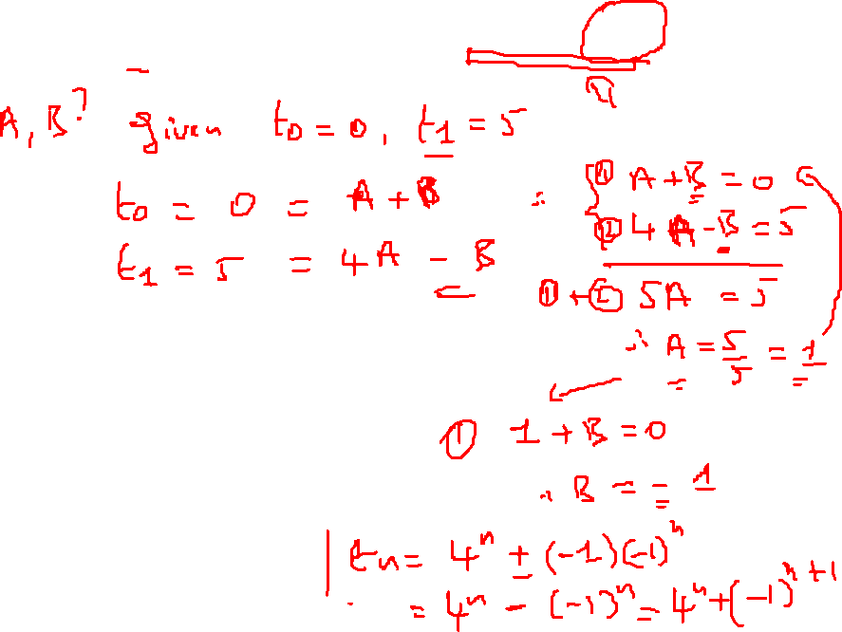

Slide 20
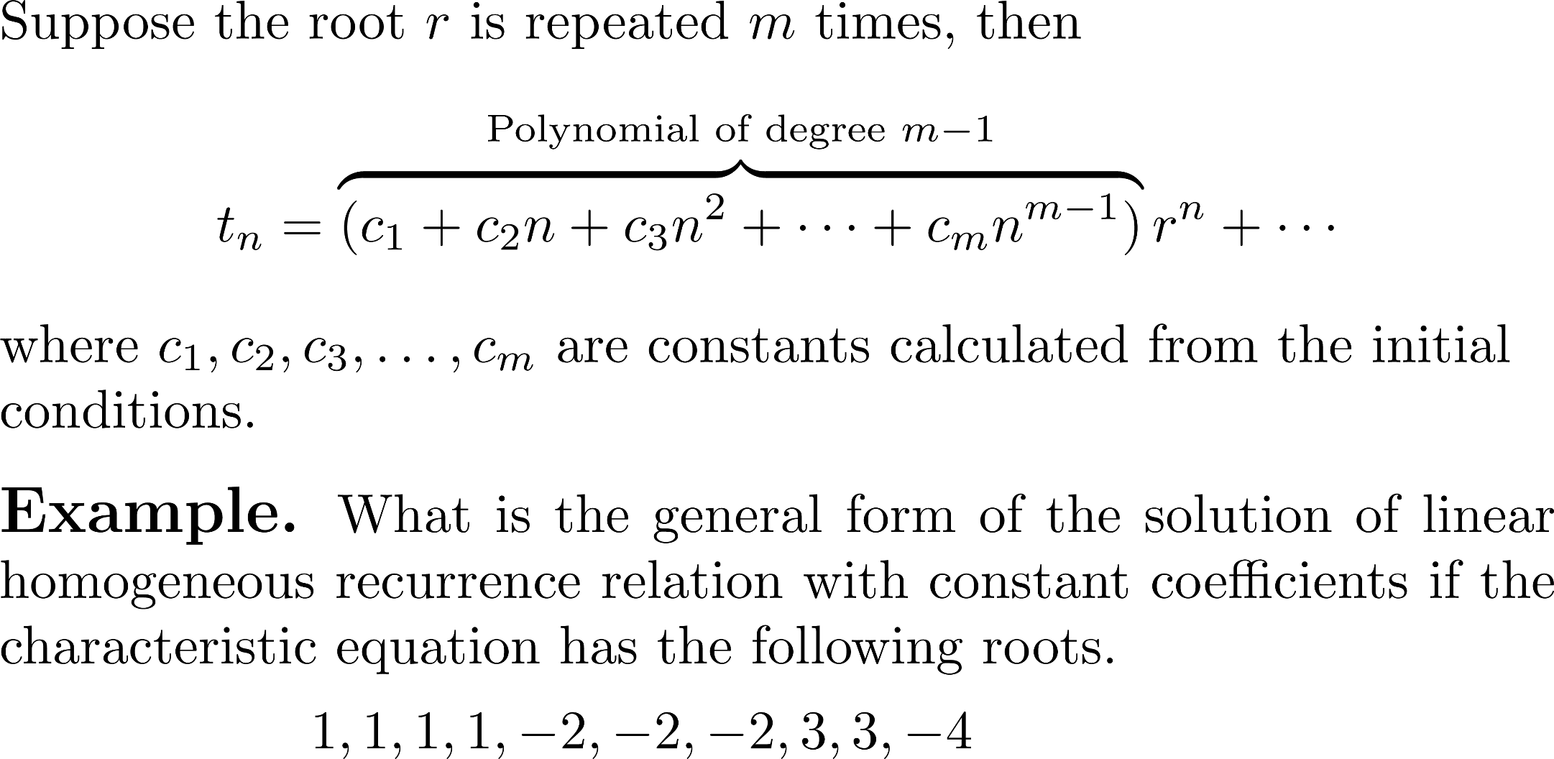
Linear Homogeneous with Constant Coefficients having Repeated Roots

Slide 21
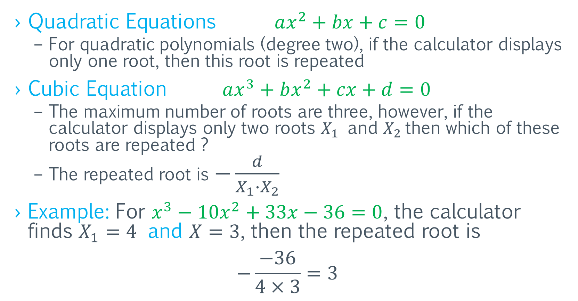
Finding Repeated Roots Using the Calculator
Quadratic Equations $ax^{2}+bx+c=0$
For quadratic polynomials (degree two), if the calculator displays only one root, then this root is repeated
Cubic Equation $ax^{3}+bx^{2}+cx+d=0$
The maximum number of roots are three, however, if the calculator displays only two roots $X_{1}$ and $X_{2}$then which of these roots are repeated ?
The repeated root is $−\frac{d}{X_{1}∙X_{2}}$
Example: For $x^{3}−10x^{2}+33x−36=0$, the calculator finds $X_{1}=4$ and $X=3$, then the repeated root is
$$−\frac{−36}{4×3}=3$$

Slide 22
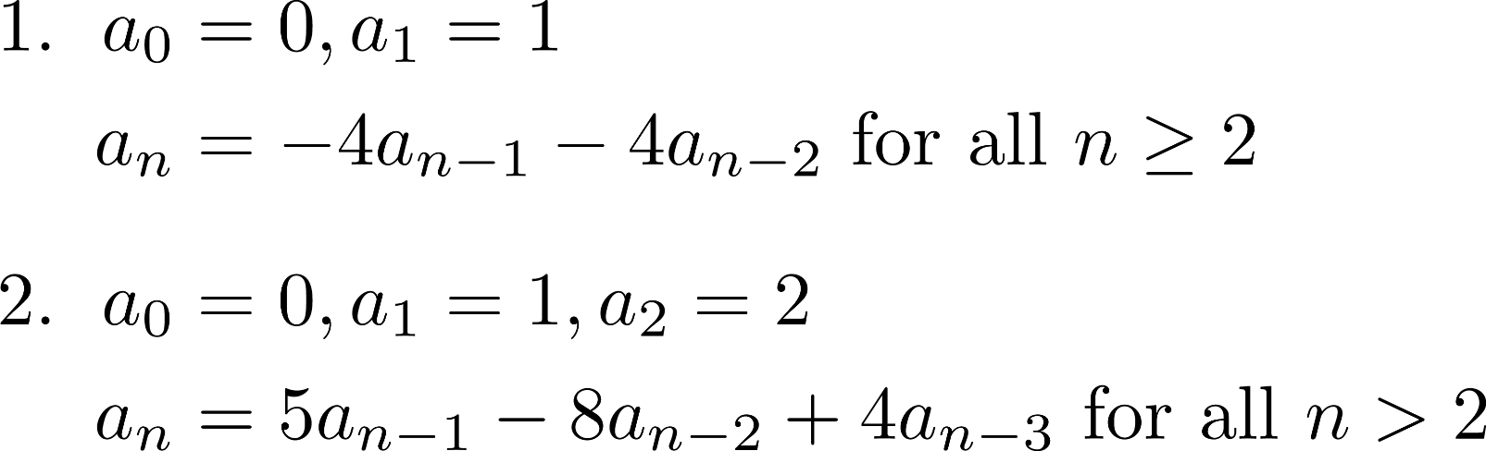
Examples

Slide 23
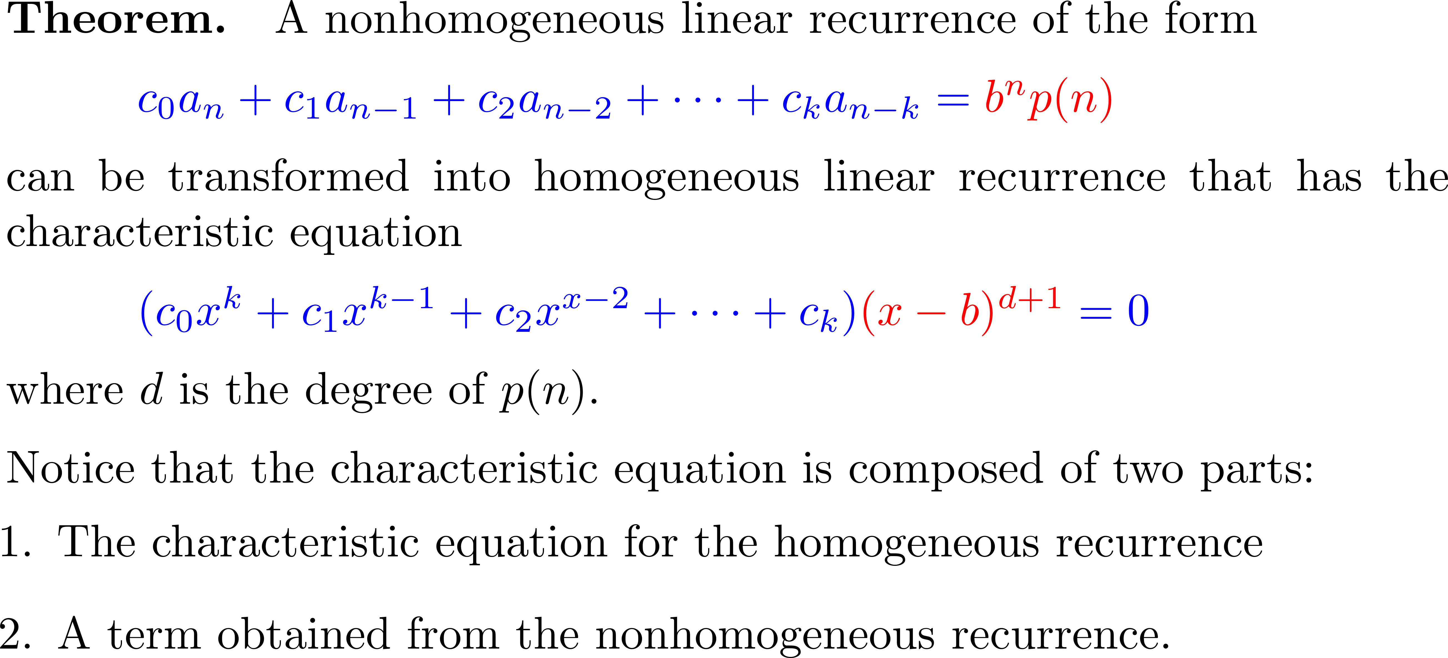
Linear Nonhomogeneous with Constant Coefficients

Slide 24
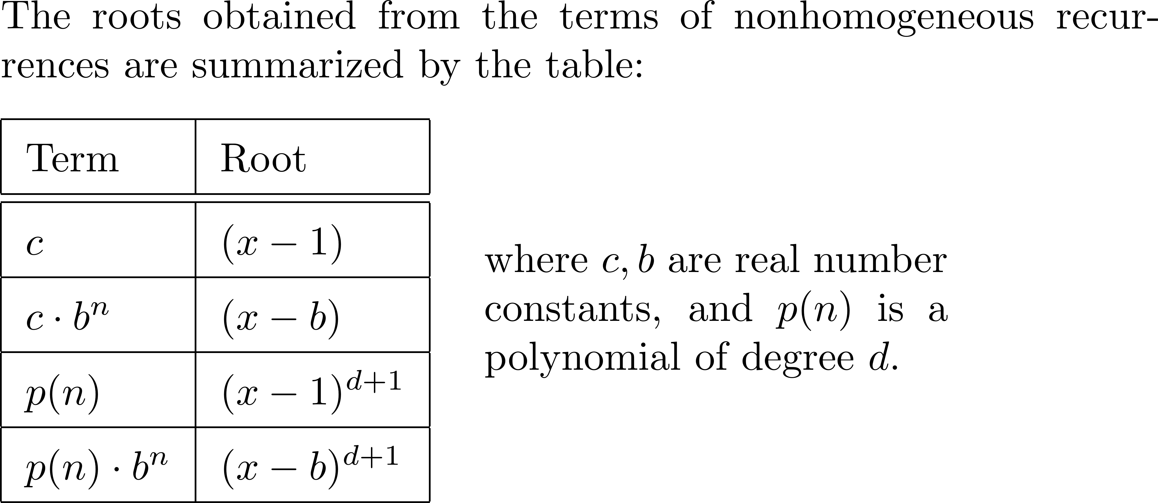
Linear Nonhomogeneous with Constant Coefficients (Cont.)

Slide 25
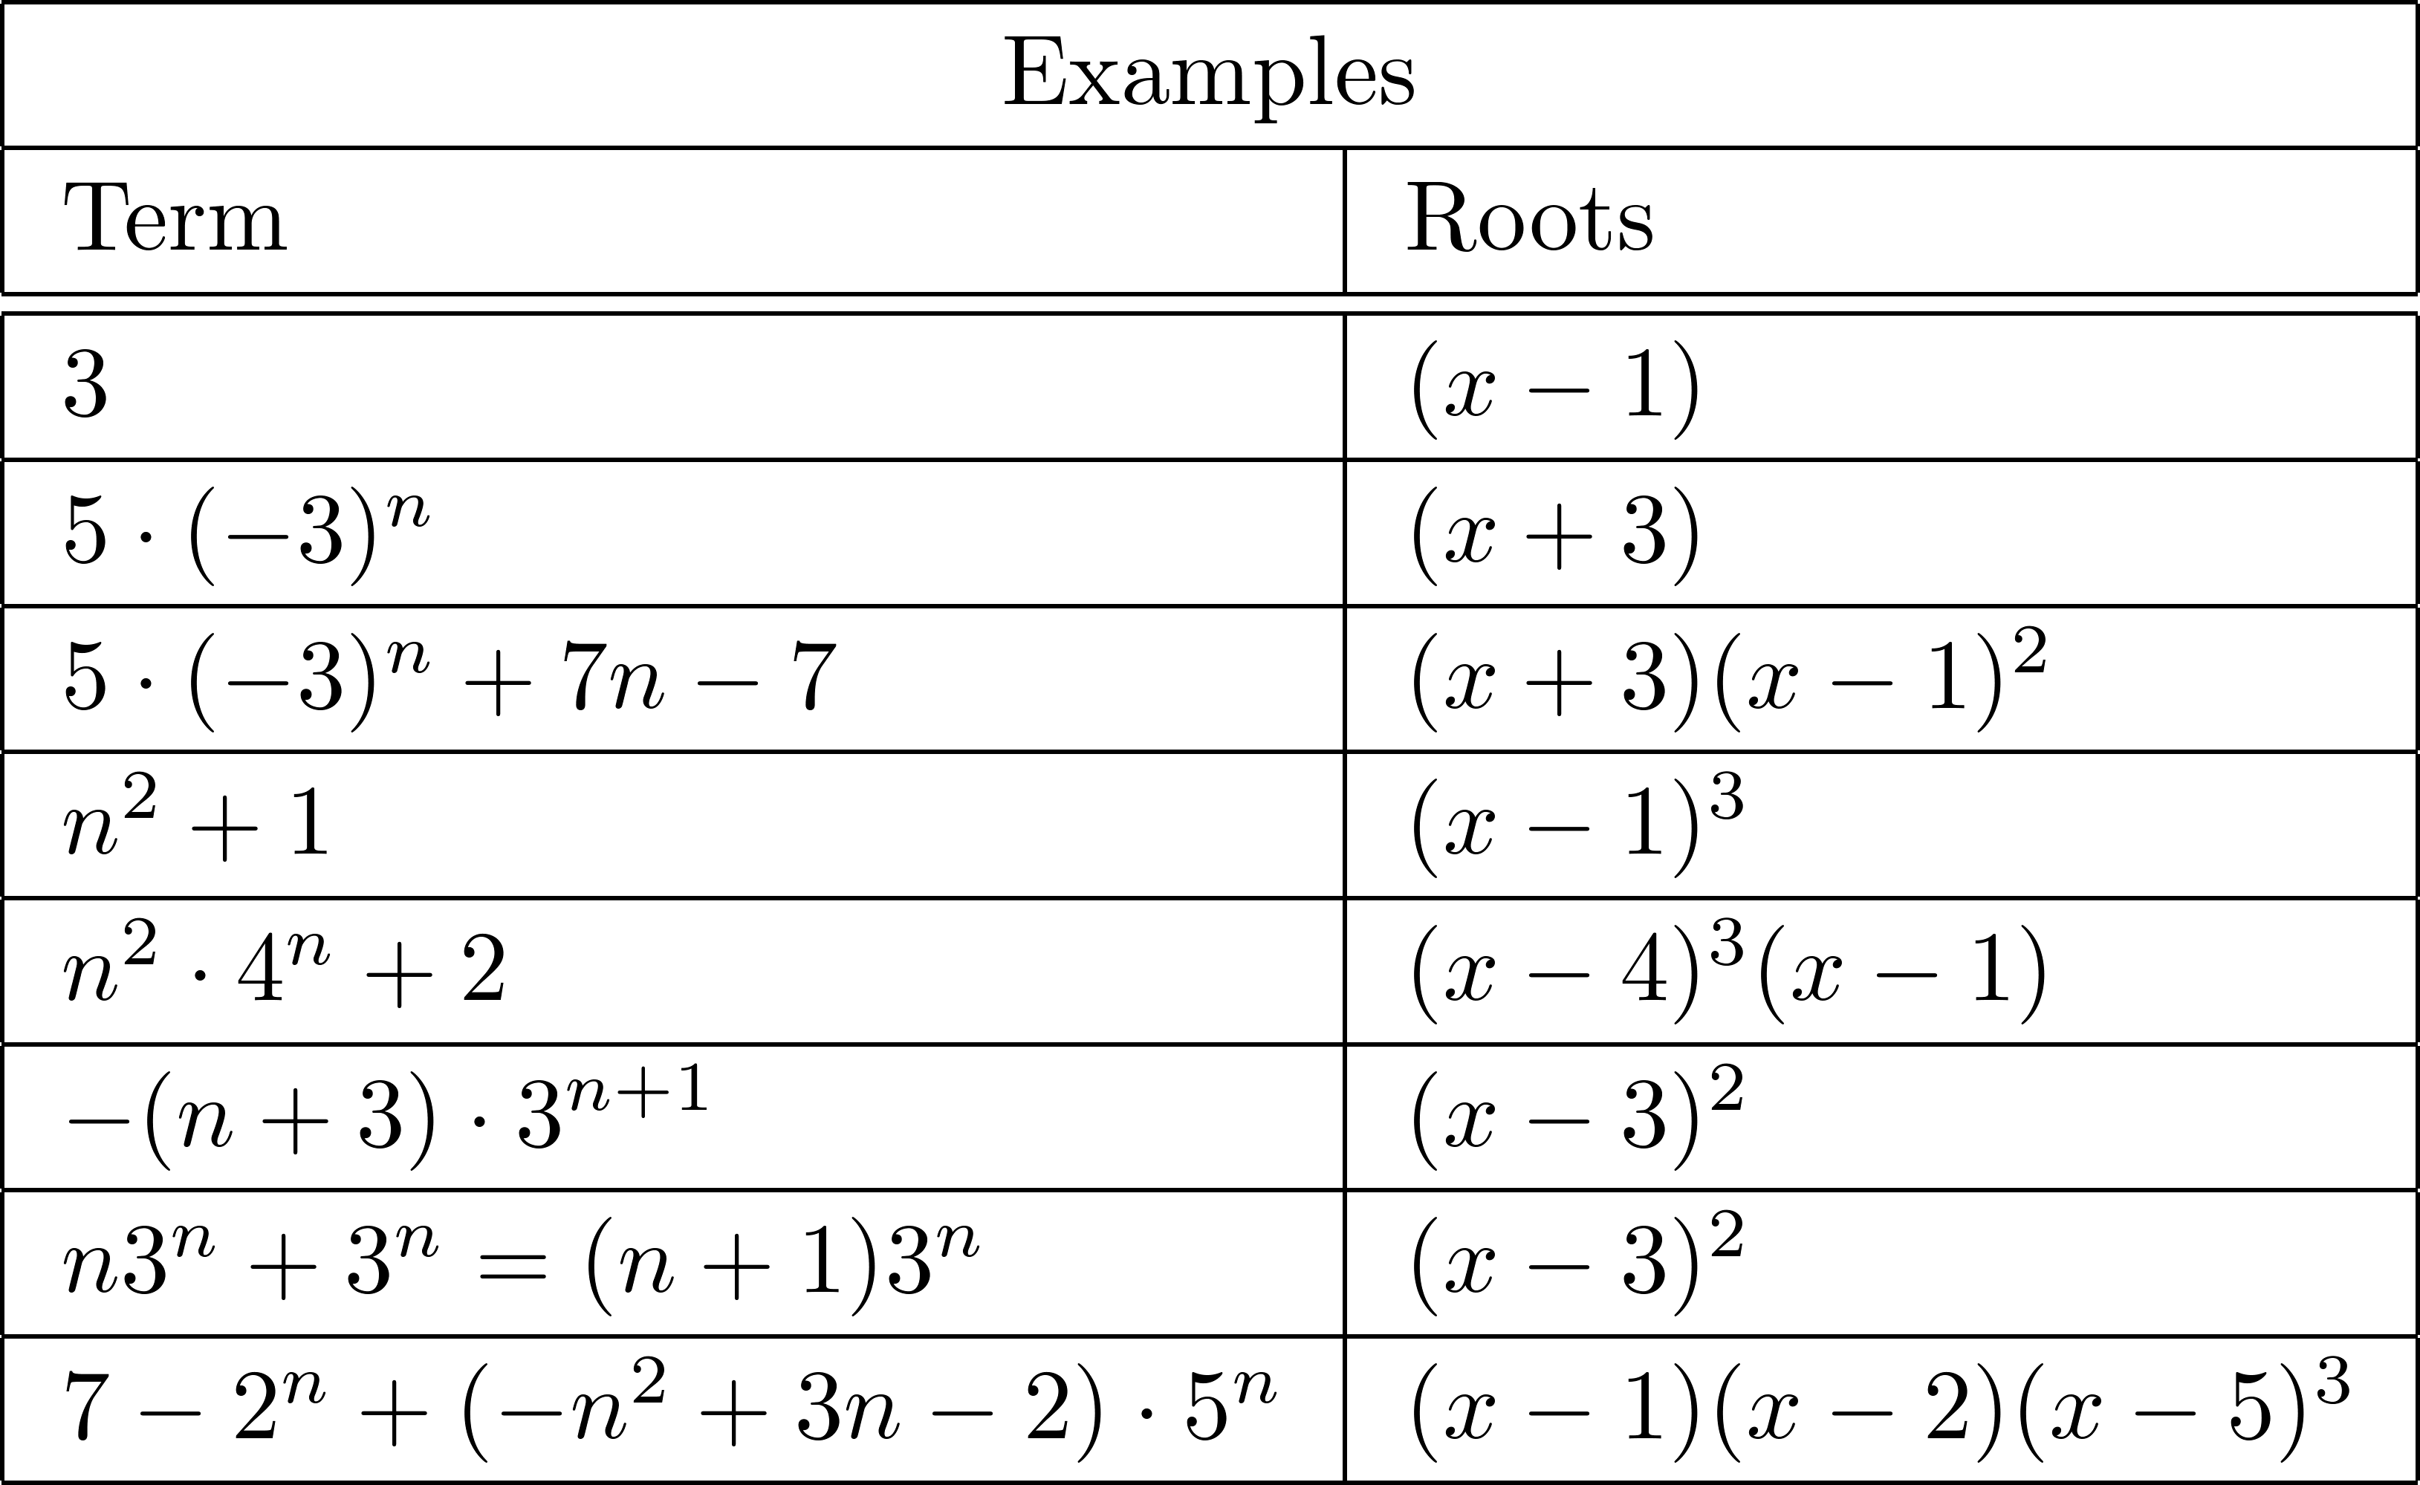
Examples

Slide 26
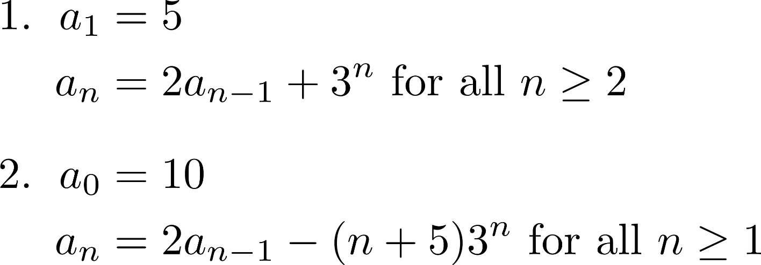
Linear Nonhomogeneous with Constant Coefficients (Cont.)

Slide 27
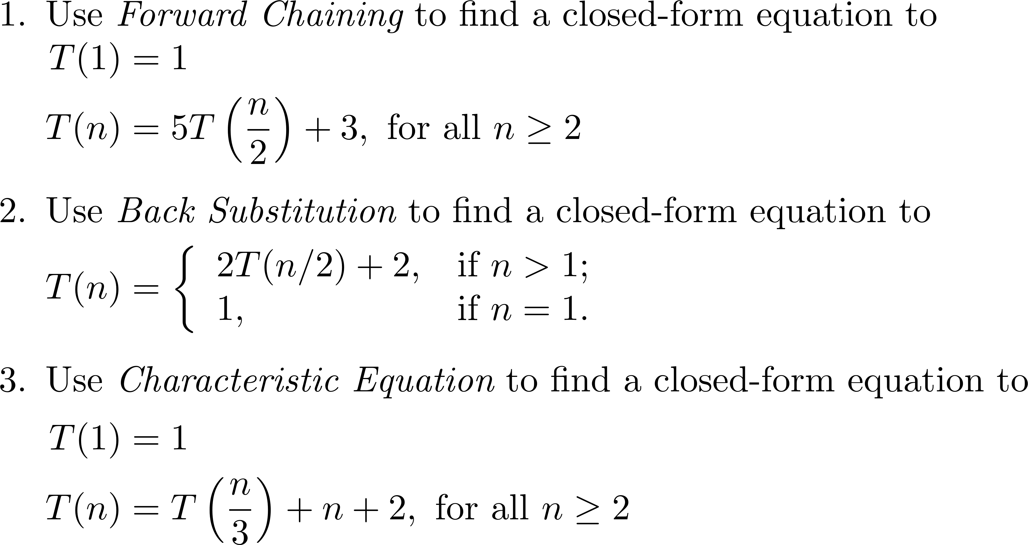
Divide-and-Conquer Relations

Slide 28
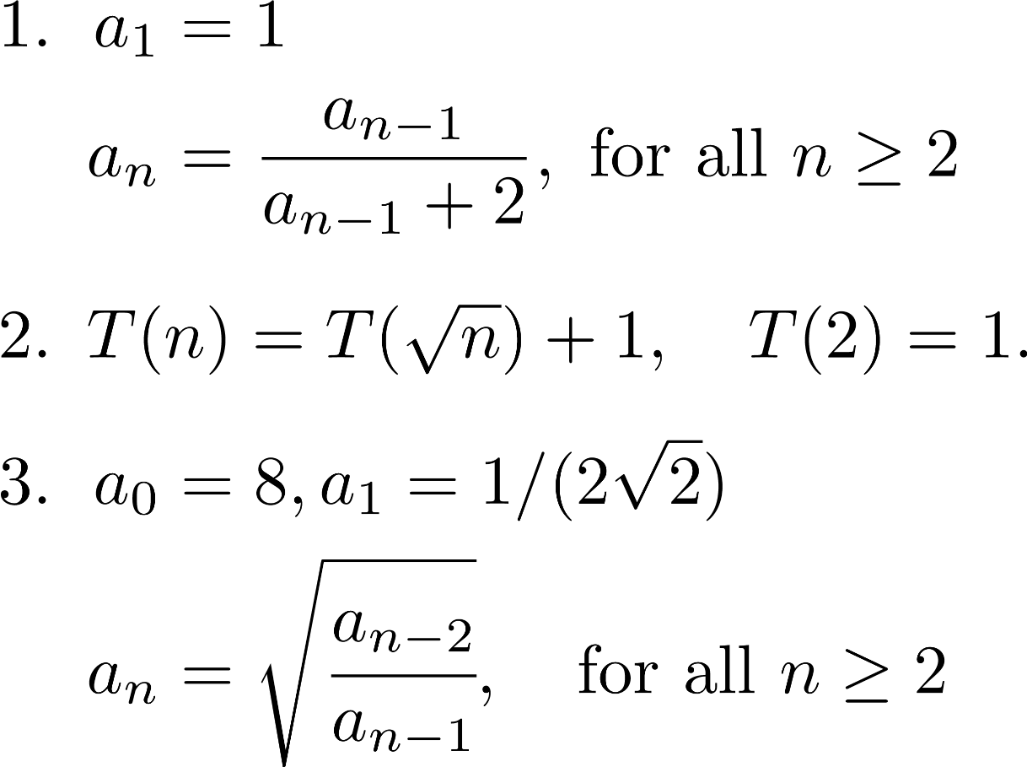
Finding a solution by Transformation

